Slide 1
FINDING MISSING PERSON USING AI
Ancila M
FIT20MCA-2019

Slide 2
Relevance of the topic
Nowadays to find a missing person is very hard task, although we all are updated by social media, it requires numerous paper work to be done and it is time consuming process and also after doing this hard work, there are not much chances of proper result.
Physically it takes huge time, as it is lengthy procedure for finding missing person as it increases time to launch an FIR in police station.
Also during handy process workforce for searching missed person is not so great and due to this half of the cases remain mysterious. An alarming fact about India’s missing children/person goes missing every day on. And half of them remain untraceable.
Hence to resolve this, We are developing Finding missing person using AI

Slide 3
Description
Face recognition is a biometric-based technology that mathematically maps a particular person’s or individual’s facial features and stores all that data.
The software uses deep learning algorithms to compare a captured image to the stored face print to verify one’s identity.
By using this technique, the information of the face of a person is saved mathematically or in the format of graphs in the database, which is used for detecting that particular face.
Face recognition model in our system will find a match of that person in the database. If a match is found, it will be notified to the police and the guardian of that person.

Slide 4
Objectives
The usual process to track a person is using investigation which requires time and experience. Most of the time, investigation method works pretty well but it is time consuming and can be unsuccessful if the person (missing) has been shifted/moved to different location
The objective of this project is to help Police and higher authorities to track down missing people quickly.
This project can also be helpful for people who are not so famous and great.

Slide 5
Existing System
The existing system is a lengthy procedure and it may increase the risk of finding the missing person, as it may take more time.
Few existing application does not convey the proper information about the lost person, which is, they only give the database of missing person.
Hence to overcome this, we are building an application to find missing person/child, which will be very convenient to common people as well as police department so that they can find their loved ones within short span of time.

Slide 6
Proposed System
The proposed system contains the following Modules:
Volunteer Module:
Volunteer Registration/ Login (Using E-mail ID, Mobile Number, Password, etc.)
Filling in the details such as the location, age of the suspected missing person and then upload the image of a suspected missing person.
Police / Authority Module:
Police/ Authority/Admin Login (Using Email ID, Mobile Number, Password).
Registering Complaint about the missing person.
Uploading the image and other details of the missing person (eg. Name, Age, Sex, Living Location).
Search the uploaded image with a stored database, if found then give result as match found and also send an email to the user and if not then store as a new entry.
Inform via e-mail to the respective authority when a match is found with AWS Rekognition

Slide 7
Modules
Admin(includes Police)
Registering Complaint of the missing person.
Details of the missing person like guardian’s name, mobile number are also provided
Submitting image, location, and time at which the person went missing.
User
Recognizing the missing person and submitting there photograph to the application.
Adding the details of the photo taken like location and time.

Slide 8
Algorithms to be used
AWS recognition Algorithm
Rekognition Image is highly scalable, deep learning technology developed by Amazon’s computer vision scientists to analyze billions of images daily .
Rekognition Image uses deep neural network models to detect and label thousands of objects and scenes in your images
Amazon Rekognition is a image recognition service that makes easy for face recognition. Rekognition Algorithm lets you easily search, verify, and organize millions of images.
Amazon recognition algorithm helps us to detect objects, scenes, and faces; extracts text; recognizes and identifies inappropriate content in images. It also allows you to search and compare faces.

Slide 9
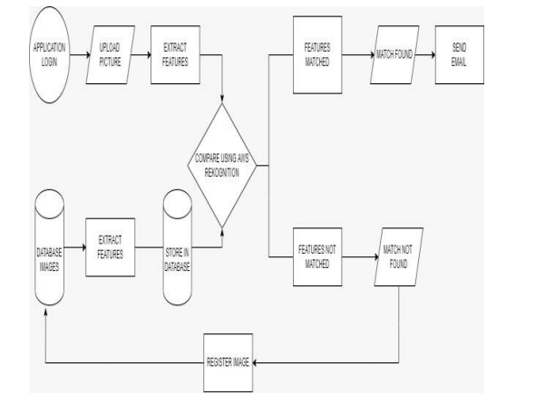
METHODOLOGY

Slide 10
THANK YOU

